Slide 1
Asclepius Healthcare App Design
Amirtha Rajan PKS

Slide 2
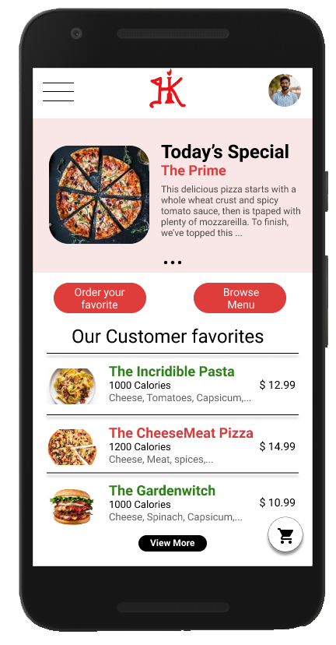
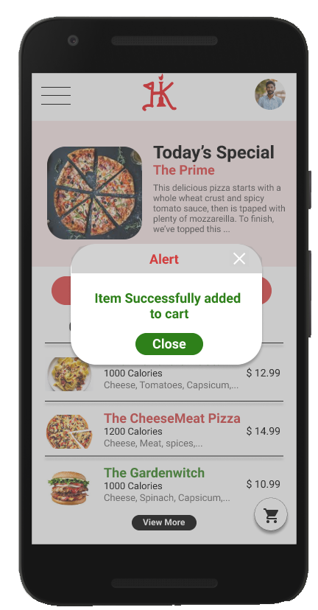
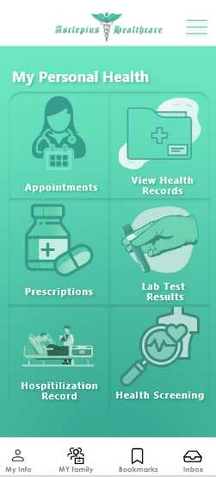
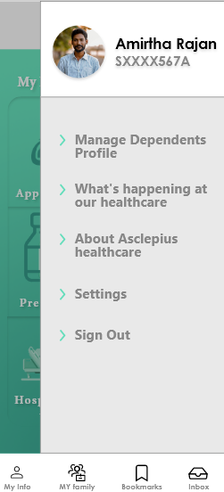
Project overview
The product:
Asclepius Healthcare is a healthcare app located in US. Asclepius Healthcare strives to deliver convenient and easy management of health and book appointments. They offer a wide spectrum of competitive service and monitoring. Asclepius Healthcare targets all customers like commuters and workers who lack the time or ability to visit hospital and wait in queue for appointments.
Project duration:
June 2021 to July 2021.

Slide 3
Project overview
The problem:
Busy workers and commuters lack the time necessary to book appointments.
The goal:
Design an app for Asclepius Healthcare that allows users to easily monitor and book appointments for doctors around you.

Slide 4
Project overview
My role:
UX designer designing an app for Asclepius Healthcare from conception to delivery.
Responsibilities:
Conducting interviews, paper and digital wireframing, low and high-fidelity prototyping, conducting usability studies, accounting for accessibility, and iterating on designs.

Slide 5
Understanding
the user
User research
Personas
Problem statements
User journey maps

Slide 6
User research: summary
I conducted interviews and created empathy maps to understand the users I’m designing for and their needs. A primary user group identified through research was working adults who don’t have time run through hospitals
to find doctors to get appointments.
This user group confirmed initial assumptions about Asclepius Healthcare clients, but research also revealed that time was not the only factor limiting users from finding an doctor for appointment. Other user problems included obligations, interests, or challenges that make it difficult to get appointments for checkup or go to hospitals in-person.

Slide 7
User research: pain points
1
2
3
Time
Accessibility
IA
Working adults are too busy to spend time on maintaing health
Platforms for consulting doctor are not equipped with assistive technologies
Text-heavy menus in apps are often difficult to read and book from

Slide 8
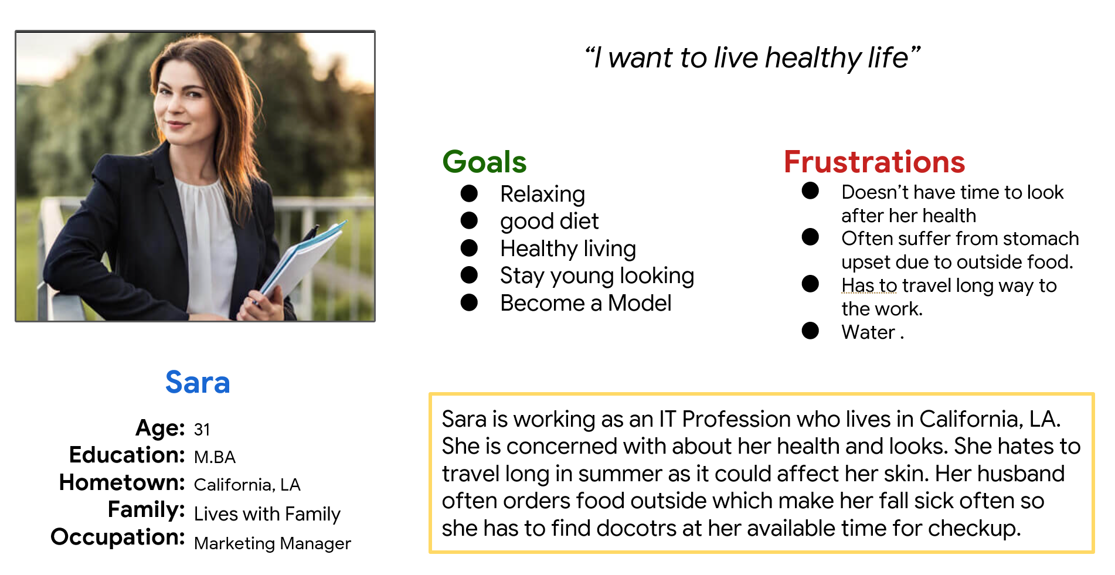
Persona: Sara
Problem statement:
Sara is working as an IT Profession who lives in California, LA. She is concerned with about her health and looks.

Slide 9
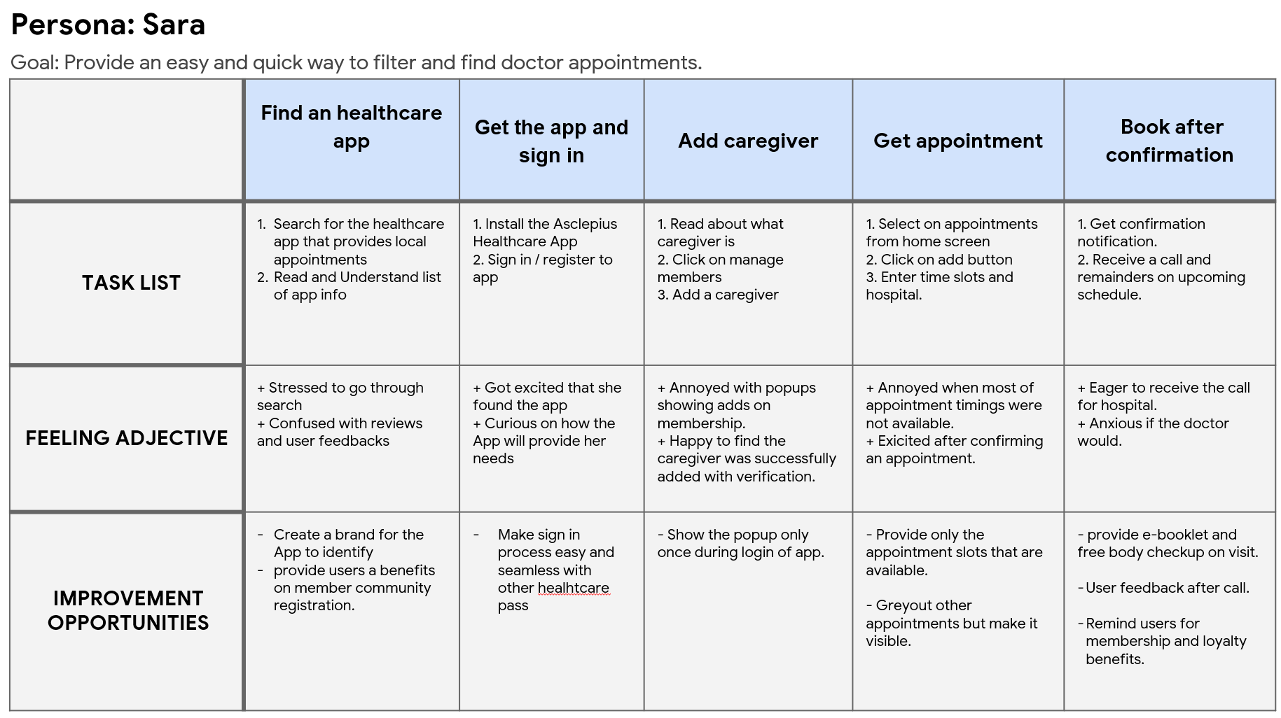
User journey map
Mapping Sara’s user journey revealed how helpful it would be for users to have access to a Asclepius healthcare app.

Slide 10
Starting
the design
Paper wireframes
Digital wireframes
Low-fidelity prototype
Usability studies

Slide 11
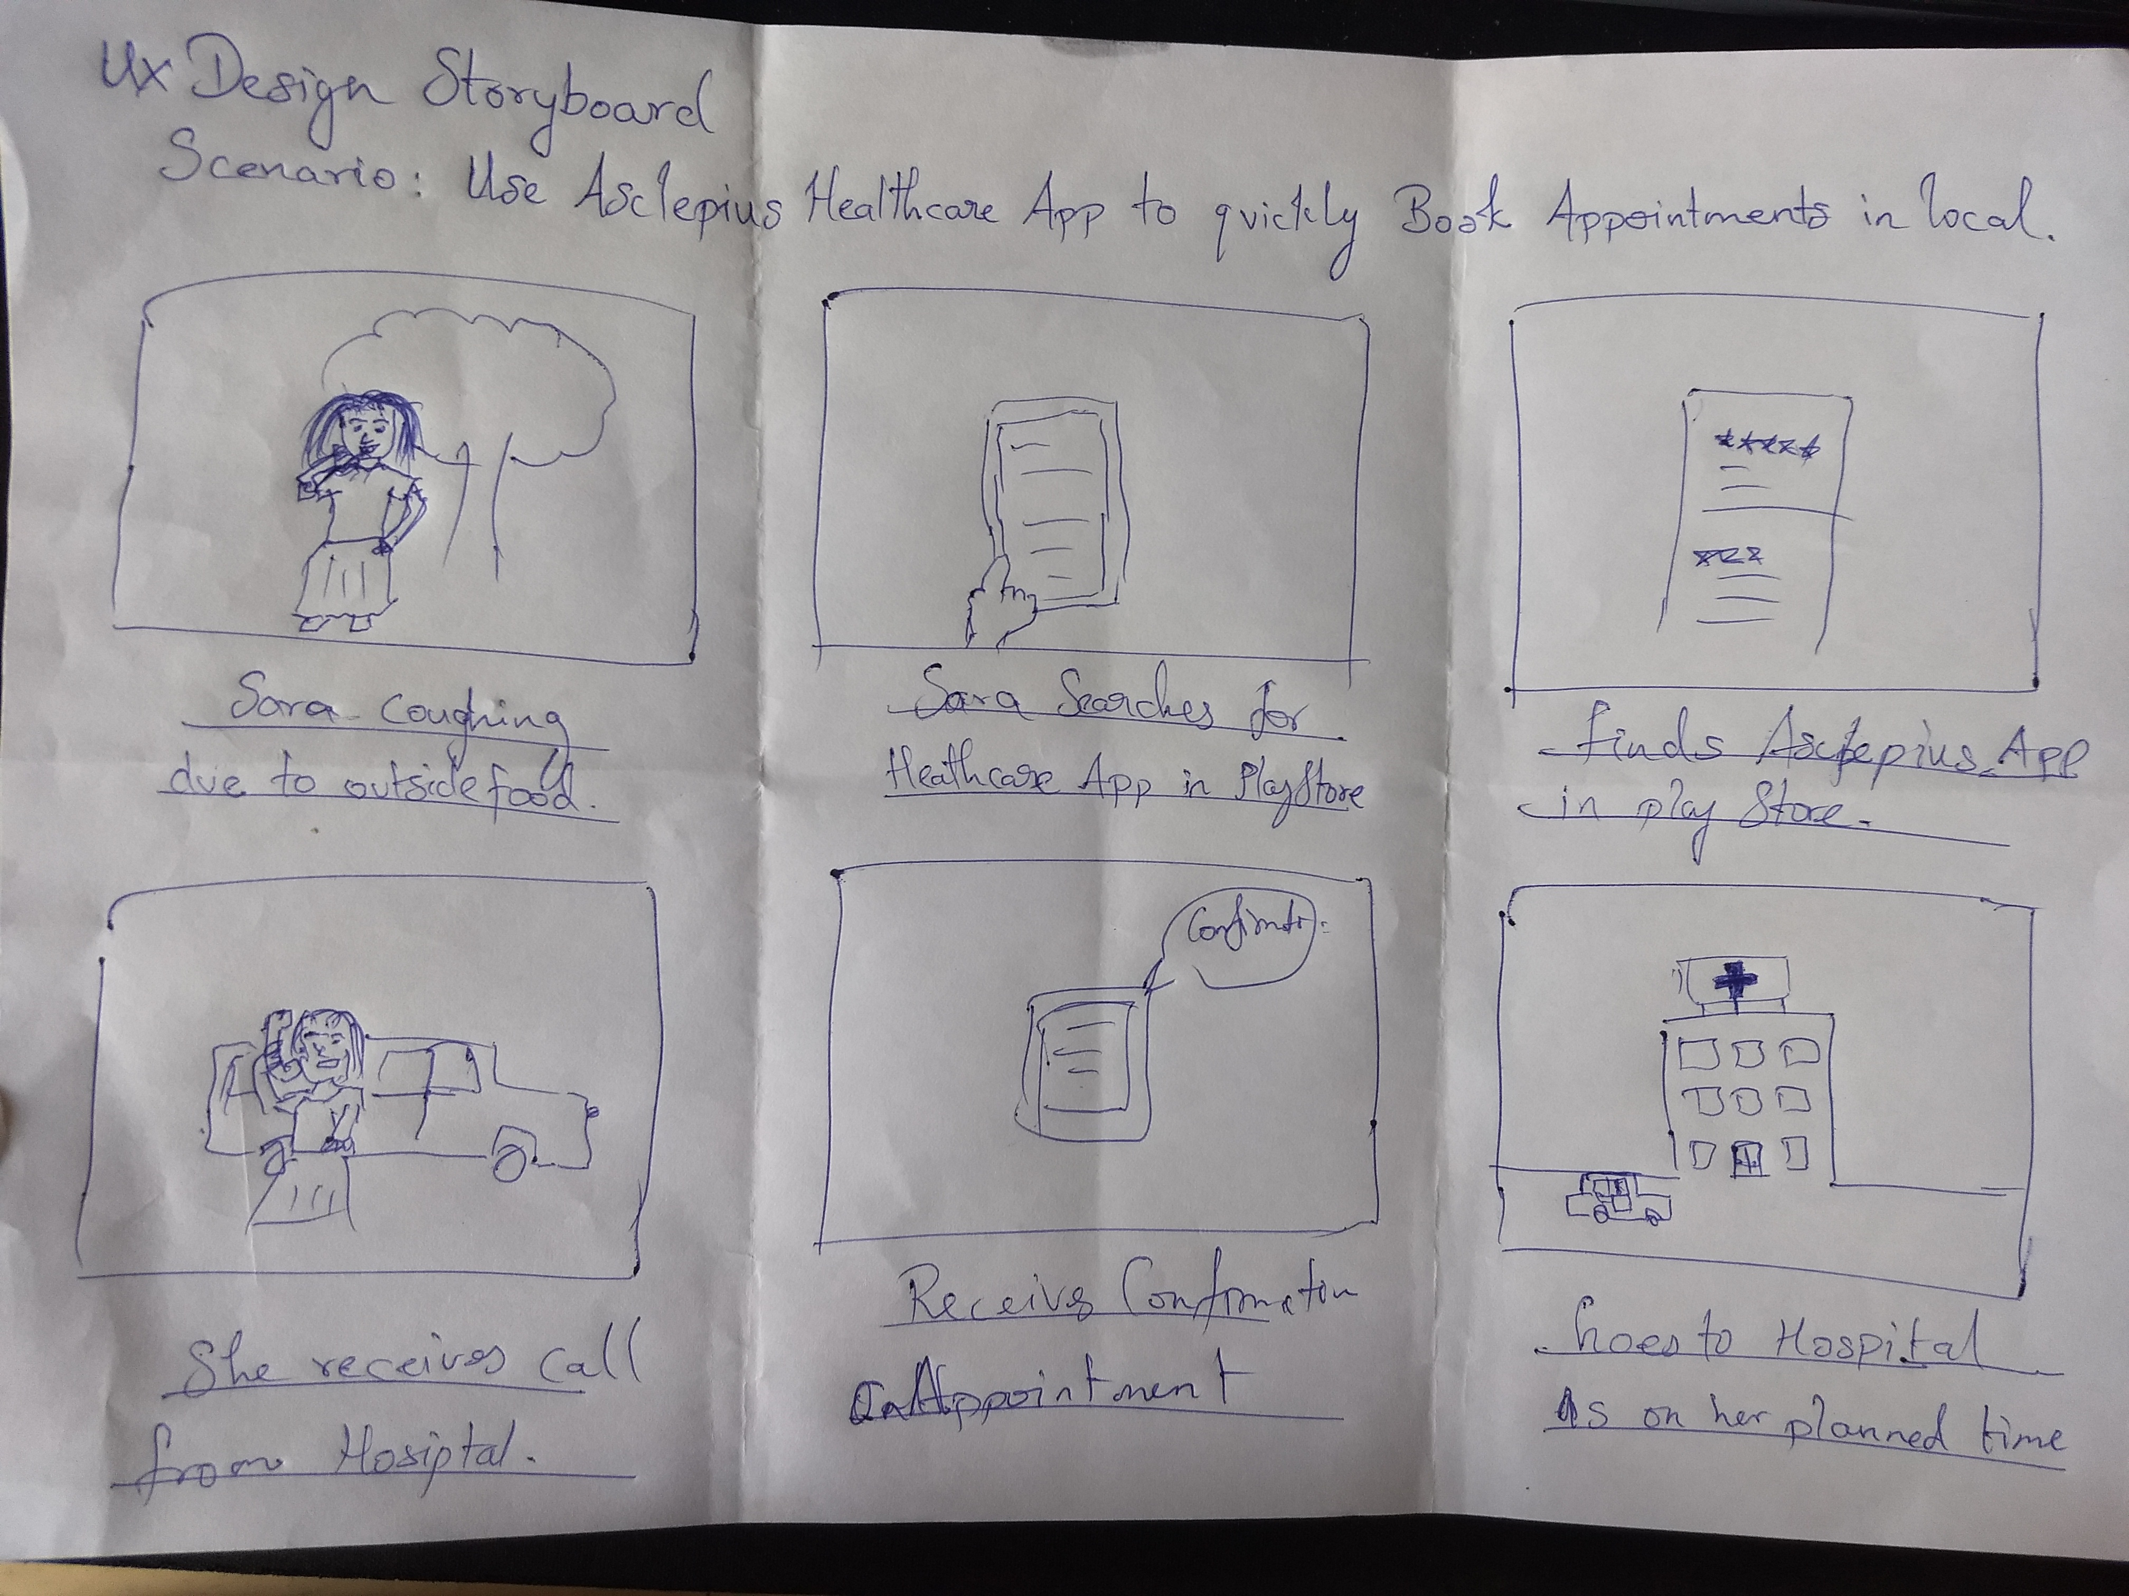
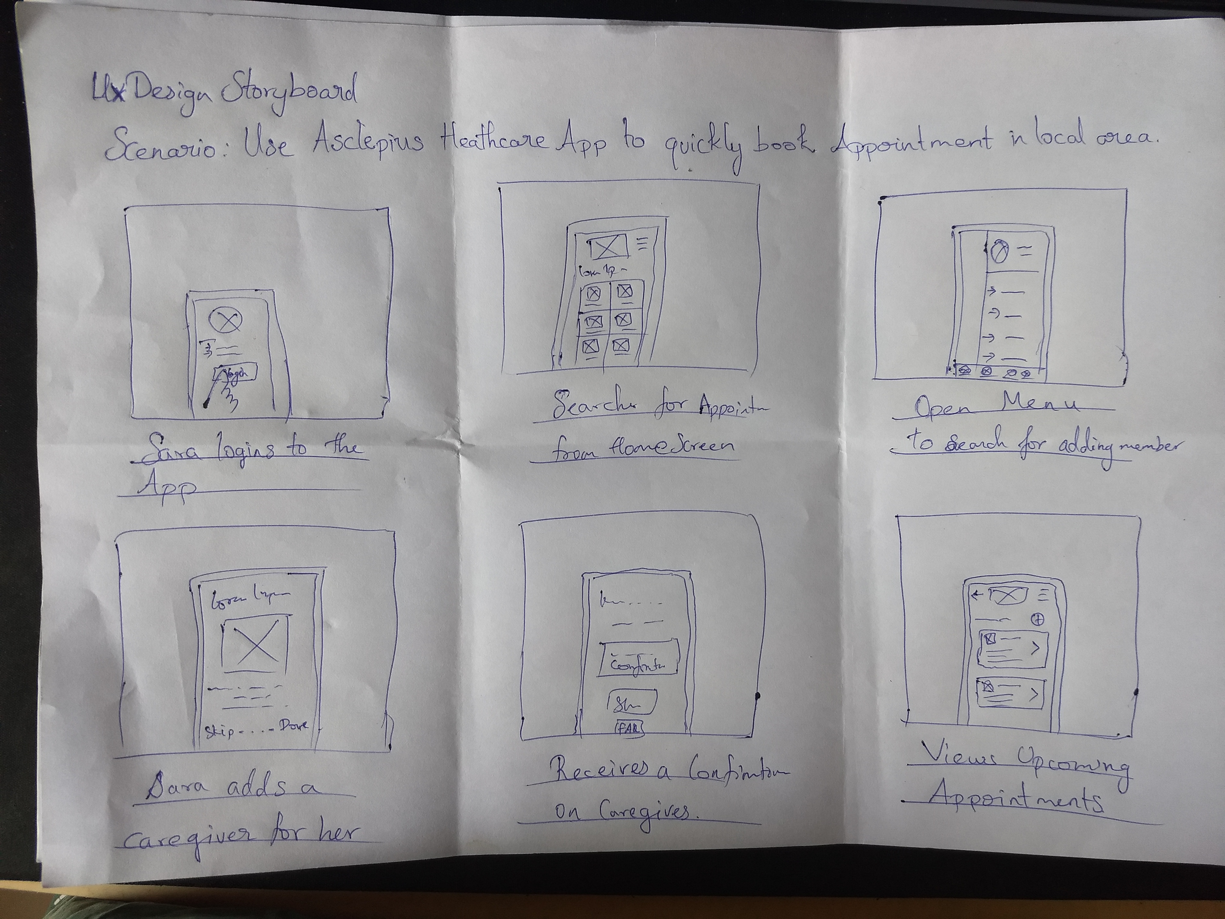
Paper wireframes
Big View : An story board of sketch for Mike ordering food from home with his colleagues.
Taking the time to draft iterations of each screen of the app on paper ensured that the elements that made it to digital wireframes would be well-suited to address user pain points. For the home screen, I prioritized a quick and easy ordering process to help users save time.
Close up :Stars were used to mark the elements of each sketch that would be used in the initial digital wireframes.

Slide 12
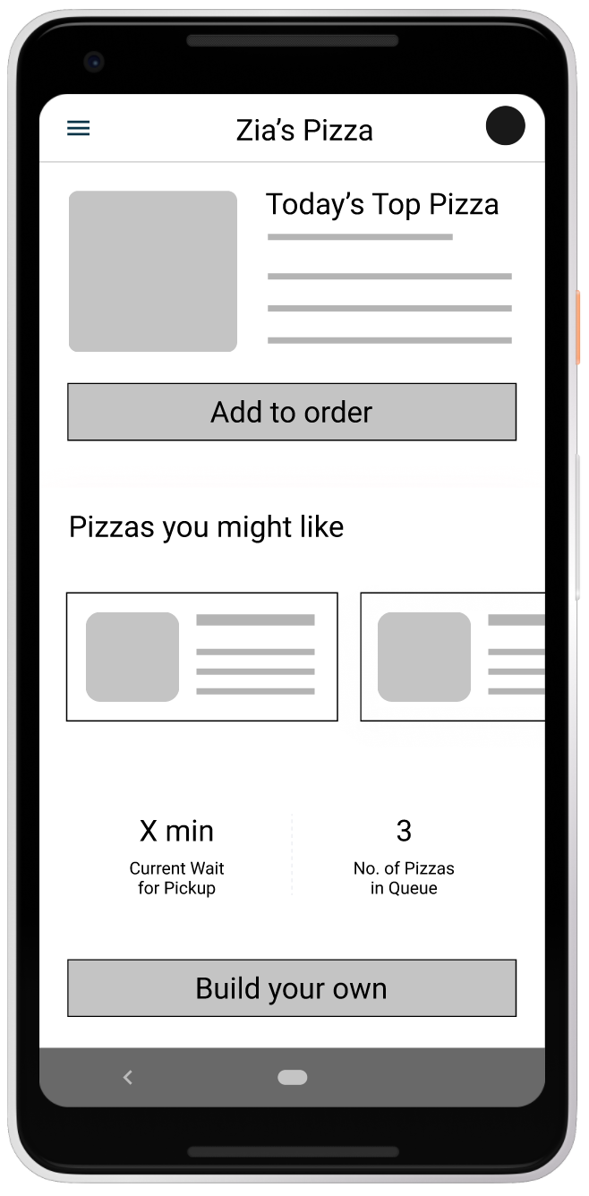
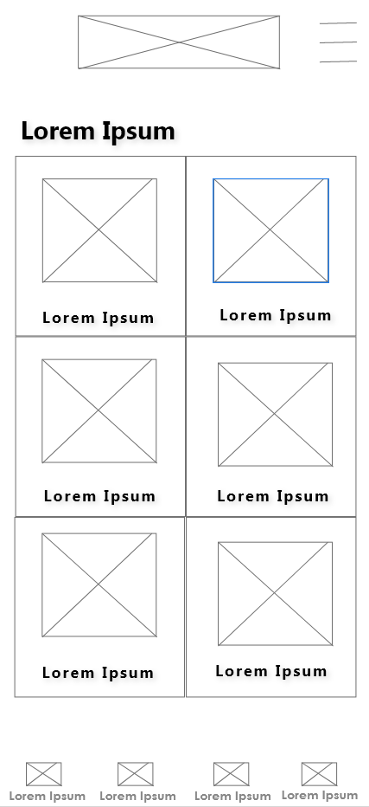
Digital wireframes
As the initial design phase continued, I made sure to base screen designs on feedback and findings from the user research.
This button at the top of the home screen makes it fast and easy for users to order.
This button provides an easy option for users to choose most ordered/favorite dish.

Slide 13
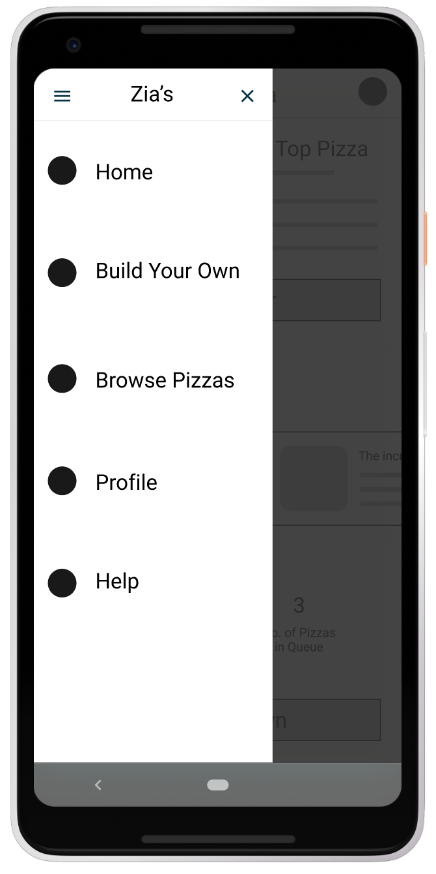
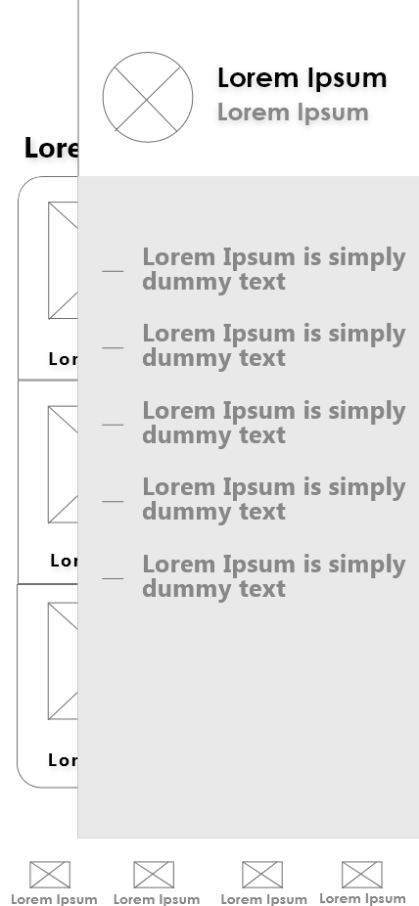
Digital wireframes
Easy access to navigation that’s screen reader friendly.
Easy navigation was a key user need to address in the designs in addition to equipping the app to work with assistive technologies.

Slide 14
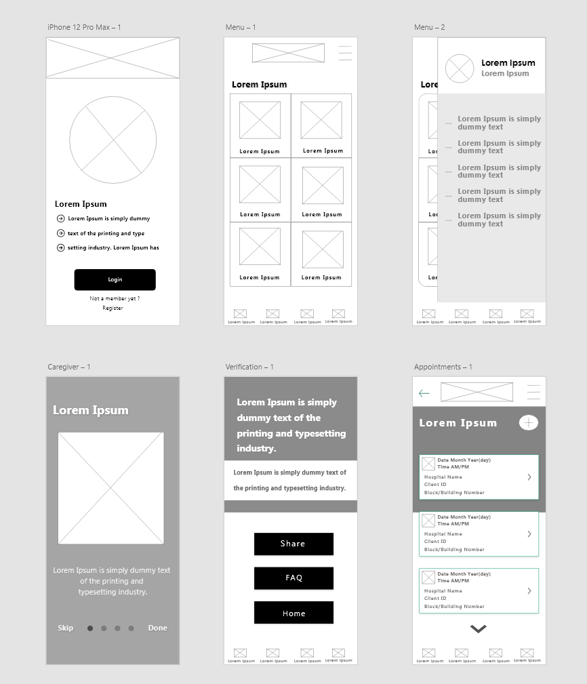
Low-fidelity prototype
Using the completed set of digital wireframes, I created a low-fidelity prototype. The primary user flow I connected was building and ordering a Italian dish, so the prototype could be used in a usability study.
View the Hestia’s Kitchen low-fidelity prototype

Slide 15
Usability study: findings
I conducted two rounds of usability studies. Findings from the first study helped guide the designs from wireframes to mockups. The second study used a high-fidelity prototype and revealed what aspects of the mockups needed refining.
Round 1 findings
Round 2 findings
1
Users want to order food quickly
1
The items in cart was not visible until checkout
Users want more customization options
Items already added to cart was not shown on the product
2
2
3
Users want a delivery Schedule option

Slide 16
Refining
the design
Mockups
High-fidelity prototype
Accessibility

Slide 17
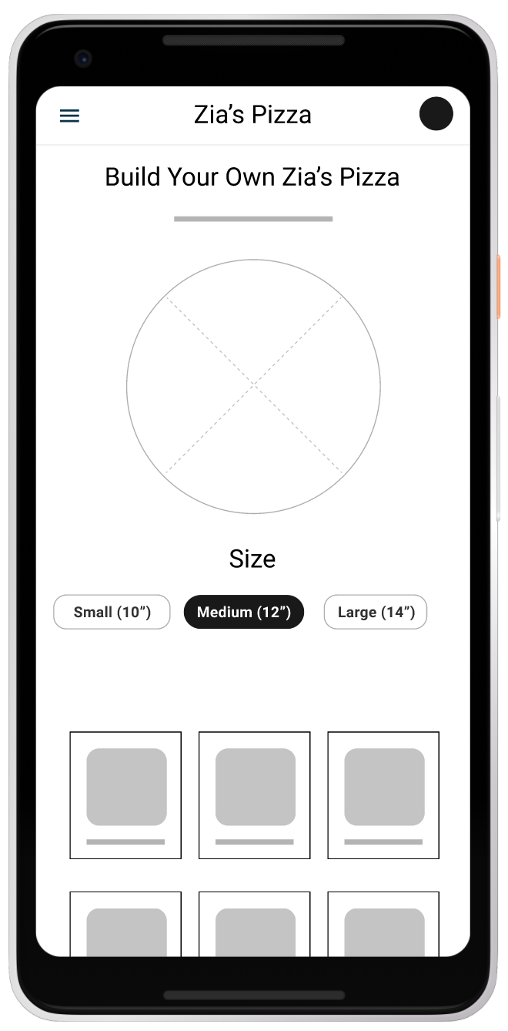
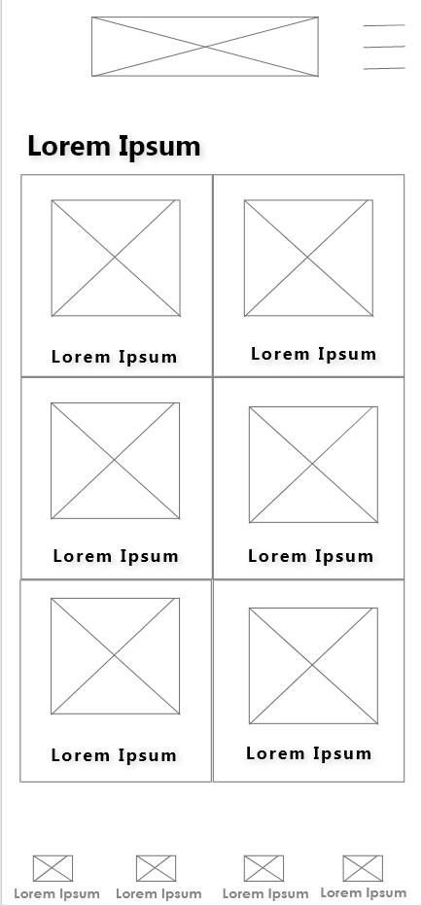
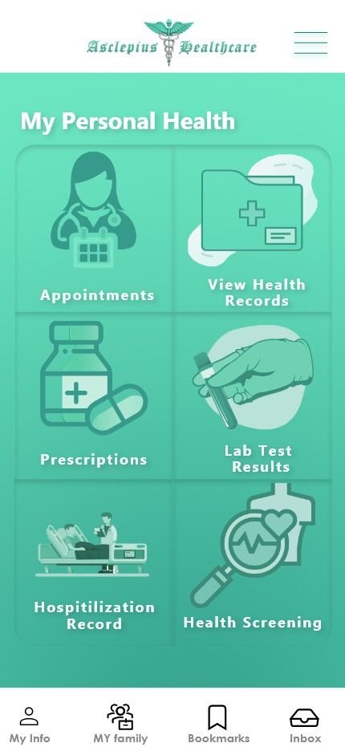
Mockups
Before usability studies
After usability studies
Early designs allowed for some customization, but after the usability studies, I added additional options to choose pizza crust and sauce. I also revised the design so users see all the customization options when they first land on the screen.

Slide 18
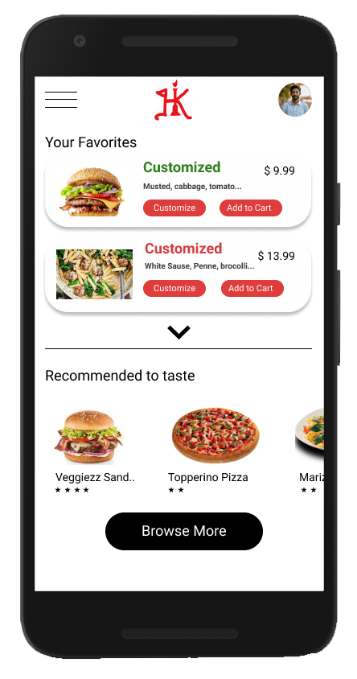
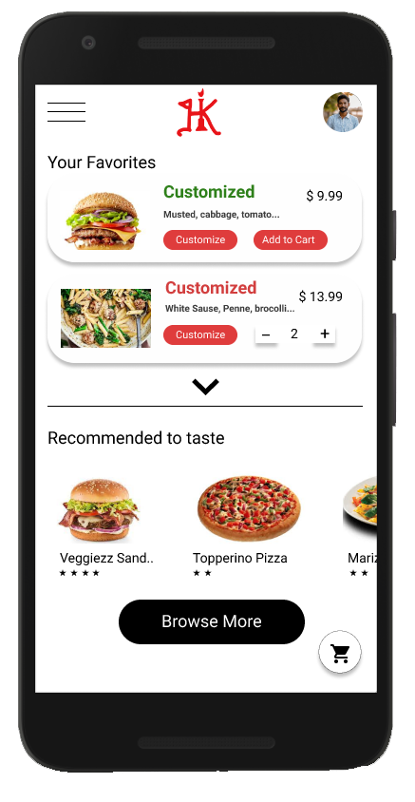
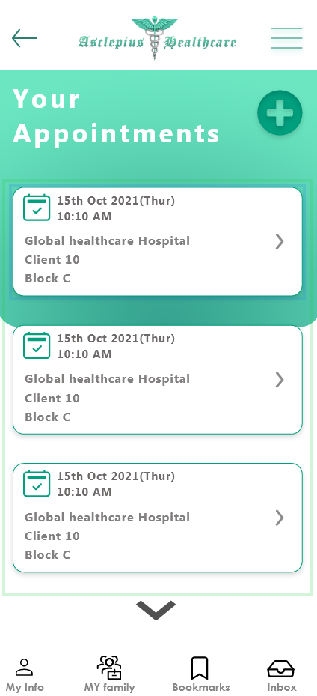
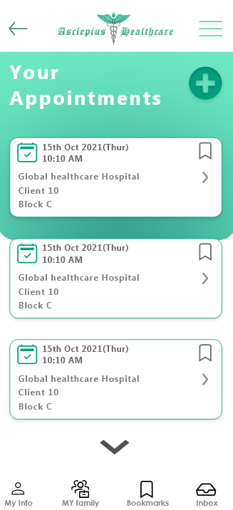
Mockups
The second usability study revealed frustration with the availablitly on items in cart , where users has to go through menu and click view cart to see the existing item quantity added to cart ,to streamline this flow, I consolidated by make this quantities available and also added a elevated cart icon to the bottom of screen.
Before usability study 2
After usability study 2

Slide 19
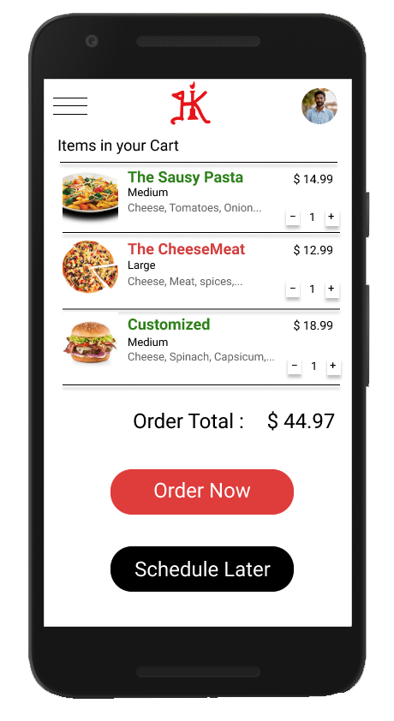
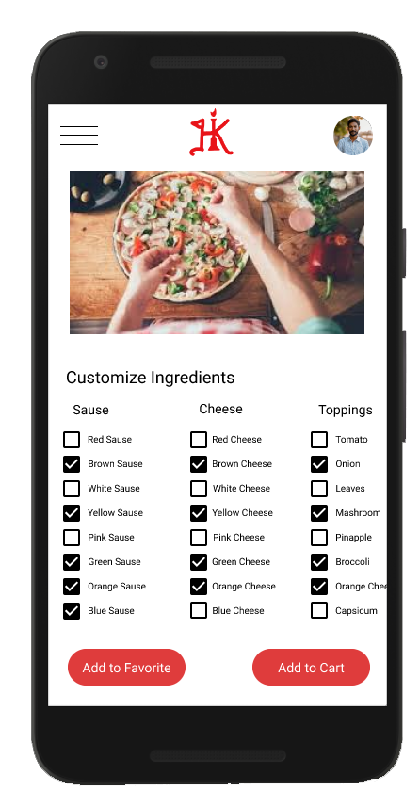


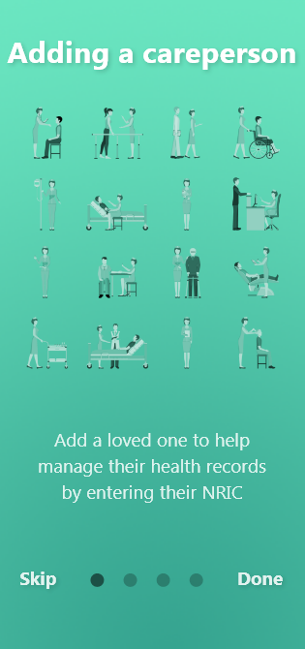
Key mockups

Slide 20
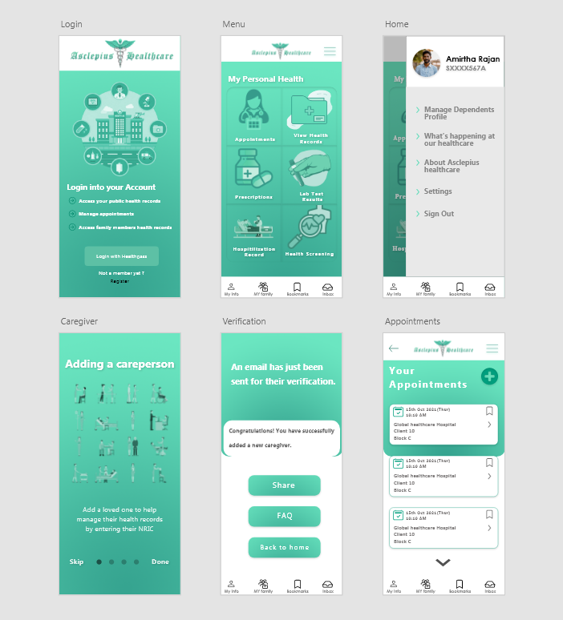
High-fidelity prototype
The final high-fidelity prototype presented cleaner user flows for ordering an dish and checkout. It also met user needs for a quick oand schedule delivery option as well as more customization.
View the Asclepius Healthcare App high-fidelity prototype

Slide 21
Accessibility considerations
1
2
3
Provided access to users who are vision impaired through adding alt text to images for screen readers.
Used icons to help make navigation easier.
Used detailed imagery for illness, dependencies and records to help all users better understand the designs.

Slide 22
Going forward
Takeaways
Next steps

Slide 23
Takeaways
Impact:
The app makes users feel like Hestia’s Kitchen App really thinks about how to meet their needs.
One quote from peer feedback:
“The app made it so easy and fun to book appointmetns as I desired! I would definitely use this app as a go-to for regular health checkups”
What I learned:
While designing the Asclepius Healthcare app, I learned that the first ideas for the app are only the beginning of the process. Usability studies and peer feedback influenced each iteration of the app’s designs.

Slide 24
Next steps
1
2
Conduct another round of usability studies to validate whether the pain points users experienced have been effectively addressed.
Conduct more user research to determine any new areas of need.

Slide 25
Let’s connect!
Thank you for your time reviewing my work on the Asclepius Healthcare! If you’d like to see more or get in touch, my contact information is provided below.
Email: amirtharajanpks@hotmail.com

Slide 26
Thank you!

